Slide 1
CSS TEXT

Slide 2
CSS TEXT
You can set the following text properties of an element:
The color property is used to set the color of a text.
The direction property is used to set the text direction.
The letter-spacing property is used to add or subtract space between the letters that make up a word.

Slide 3
CSS TEXT
The word-spacing property is used to add or subtract space between the words of a sentence.
The text-indent property is used to indent the text of a paragraph.
The text-align property is used to align the text of a document.
The text-decoration property is used to underline, overline, and strikethrough text.

Slide 4
CSS TEXT
The text-transform property is used to capitalize text or convert text to uppercase or lowercase letters.
The white-space property is used to control the flow and formatting of text.
The text-shadow property is used to set the text shadow around a text.

Slide 5

Set the Text Color
The following example demonstrates how to set the text color.
Possible value could be any color name in any valid format.
<p style="color:red;">
This text will be written in red.
</p>
It will produce the following result:

Slide 6

Set the Text Direction
The following example demonstrates how to set the direction of a text.
Possible values are ltr or rtl.
<p style="direction:rtl;">
This text will be renedered from right to left
</p>
It will produce the following result:

Slide 7
Set the Space between Characters
The following example demonstrates how to set the space between characters.
Possible values are normal or a number specifying space.
<p style="letter-spacing:5px;">
This text is having space between letters.
</p>
It will produce the following result:

Slide 8

Set the Space between Words
The following example demonstrates how to set the space between words.
Possible values are normal or a number specifying space.
<p style="word-spacing:5px;">
This text is having space between words.
</p>
It will produce the following result:

Slide 9
Set the Text Indent
The following example demonstrates how to indent the first line of a paragraph.
Possible values are % or a number specifying indent space.

Slide 10
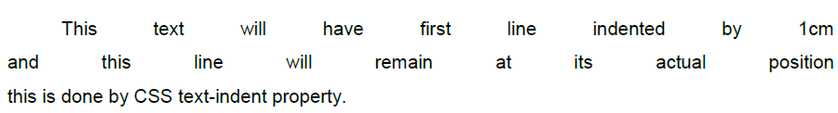
Set the Text Indent
<p style="text-indent:1cm;">
This text will have first line indented by 1cm
and this line will remain at its actual position
this is done by CSS text-indent property.
</p>
It will produce the following result:

Slide 11
Set the Text Alignment
The following example demonstrates how to align a text.
Possible values are left, right, center, justify.

Slide 12
Set the Text Alignment
<p style="text-align:right;">
This will be right aligned.
</p>
<p style="text-align:center;">
This will be center aligned.
</p>
<p style="text-align:left;">
This will be left aligned.
</p>

Slide 13
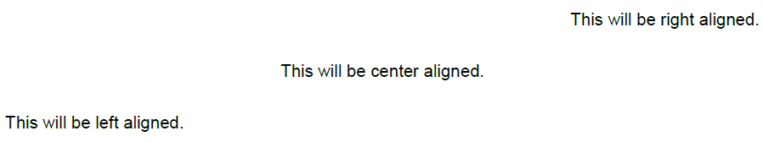
Set the Text Alignment
It will produce the following result:

Slide 14
Decorating the Text
The following example demonstrates how to decorate a text.
Possible values are none, underline, overline, line-through, blink.

Slide 15
Decorating the Text
<p style="text-decoration:underline;">
This will be underlined </p>
<p style="text-decoration:line-through;">
This will be striked through. </p>
<p style="text-decoration:overline;">
This will have a over line. </p>
<p style="text-decoration:blink;">
This text will have blinking effect </p>

Slide 16
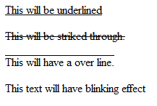
Decorating the Text
It will produce the following result:

Slide 17
Set the Text Cases
The following example demonstrates how to set the cases for a text.
Possible values are none, capitalize, uppercase, lowercase.

Slide 18
Set the Text Cases
<p style="text-transform:capitalize;">
This will be capitalized </p>
<p style="text-transform:uppercase;">
This will be in uppercase </p>
<p style="text-transform:lowercase;">
This will be in lowercase </p>

Slide 19
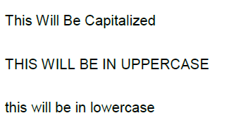
Set the Text Cases
It will produce the following result:

Slide 20
Set the White Space between Text
The following example demonstrates how white space inside an element is handled.
Possible values are normal, pre, nowrap.
<p style="white-space:pre;">This text has a line break and the white-space pre setting tells the browser to honor it just like the HTML pre tag.</p>

Slide 21
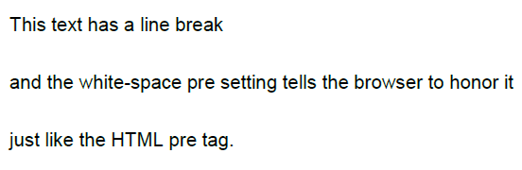
Set the White Space between Text
It will produce the following result:

Slide 22
Set the Text Shadow
The following example demonstrates how to set the shadow around a text.
This may not be supported by all the browsers.
<p style="text-shadow:4px 4px 8px blue;">
If your browser supports the CSS text-shadow property,
this text will have a blue shadow.</p>

Slide 23
Set the Text Shadow
It will produce the following result:

Slide 24
IMAGES
Images play an important role in any webpage.
Though it is not recommended to include a lot of images, but it is still important to use good images wherever required.
CSS plays a good role to control image display.
You can set the following image properties using CSS.

Slide 25
IMAGES
The border property is used to set the width of an image border.
The height property is used to set the height of an image.
The width property is used to set the width of an image.
The -moz-opacity property is used to set the opacity of an image.

Slide 26
The Image Border Property
The border property of an image is used to set the width of an image border.
This property can have a value in length or in %.
A width of zero pixels means no border.
Here is an example:

Slide 27
The Image Border Property
<img style="border:0px;" src="/images/css.gif" />
<br />
<img style="border:3px dashed red;" src="/images/css.gif" />

Slide 28
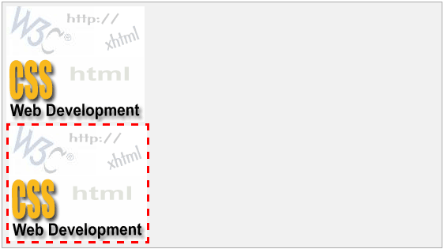
The Image Border Property
It will produce the following result:

Slide 29
The Image Height Property
The height property of an image is used to set the height of an image.
This property can have a value in length or in %.
While giving value in %, it applies it in respect of the box in which an image is available.
Here is an example:

Slide 30
The Image Height Property
<img style="border:1px solid red; height:100px;“ src="/images/css.gif" />
<br />
<img style="border:1px solid red; height:50%;" src="/images/css.gif" />

Slide 31
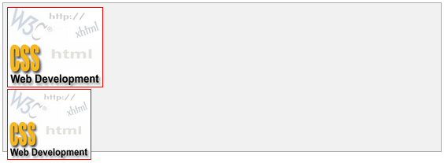
The Image Height Property
It will produce the following result:

Slide 32
The Image Width Property
The width property of an image is used to set the width of an image.
This property can have a value in length or in %.
While giving value in %, it applies it in respect of the box in which an image is available.
Here is an example:

Slide 33
The Image Width Property
<img style="border:1px solid red; width:100px;“ src="/images/css.gif" />
<br />
<img style="border:1px solid red; width:100%;“ src="/images/css.gif" />
It will produce the following result:

Slide 34

The Image Width Property

Slide 35
The -moz-opacity Property
The -moz-opacity property of an image is used to set the opacity of an image.
This property is used to create a transparent image in Mozilla.
IE uses filter:alpha(opacity=x) to create transparent images.

Slide 36
The -moz-opacity Property
In Mozilla (-moz-opacity:x), x can be a value from 0.0 - 1.0.
A lower value makes the element more transparent (The same things goes for the CSS3-valid syntax opacity:x).
In IE (filter:alpha(opacity=x)), x can be a value from 0 - 100.
A lower value makes the element more transparent.

Slide 37

The -moz-opacity Property
Here is an example:
<img style="border:1px solid red;-moz-opacity:0.4;filter:alpha(opacity=40);"
src="/images/css.gif" />
It will produce the following result:

Slide 38
LINKS
You can set the following properties of a hyperlink:
The :link signifies unvisited hyperlinks.
The :visited signifies visited hyperlinks.
The :hover signifies an element that currently has the user's mouse pointer hovering over it.
The :active signifies an element on which the user is currently clicking.

Slide 39
LINKS
Usually, all these properties are kept in the header part of the HTML document.
Remember a:hover MUST come after a:link and a:visited in the CSS definition in order to be effective.
Also, a:active MUST come after a:hover in the CSS definition as follows:

Slide 40
LINKS
<style type="text/css">
a:link {color: #000000}
a:visited {color: #006600}
a:hover {color: #FFCC00}
a:active {color: #FF00CC}
</style>
Now, we will see how to use these properties to give different effects to hyperlinks.

Slide 41
Set the Color of Links
The following example demonstrates how to set the link color.
Possible values could be any color name in any valid format.
<style type="text/css">
a:link {color:#000000}
</style>
<a href="/html/index.htm">Black Link</a>

Slide 42

Set the Color of Links
It will produce the following black link:

Slide 43
Set the Color of Visited Links
The following example demonstrates how to set the color of the visited links.
Possible values could be any color name in any valid format.
<style type="text/css">
a:visited {color: #006600}
</style>
<a href="/html/index.htm">Click this link</a>

Slide 44


Set the Color of Visited Links
It will produce the following link.
Once you click this link, it will change its color to green.

Slide 45
Change the Color of Links when Mouse is Over
The following example demonstrates how to change the color of links when we bring a mouse pointer over that link.
Possible values could be any color name in any valid format.

Slide 46
Change the Color of Links when Mouse is Over
<style type="text/css">
a:hover {color: #FFCC00}
</style>
<a href="/html/index.htm">Bring Mouse Here</a>

Slide 47
Change the Color of Links when Mouse is Over
It will produce the following link.
Now, you bring your mouse over this link and you will see that it changes its color to yellow.

Slide 48
Change the Color of Active Links
The following example demonstrates how to change the color of active links.
Possible values could be any color name in any valid format.
<style type="text/css">
a:active {color: #FF00CC}
</style>
<a href="/html/index.htm">Click This Link</a>

Slide 49

Change the Color of Active Links
It will produce the following link.
It will change its color to pink when the user clicks it.

